Slide 1


Cognitive Biases in Decision Making
Notes:
As humans, we make decisions most of our waking hours. However, our decisions can be significantly affected as a result of some of the cognitive biases and heuristics that we have. In this presentation, we will briefly introduce some of the existing decision theory frameworks and their shortcomings. We will then introduce and discuss a number of well-known heuristic biases. Understanding these vulnerabilities will help us better appreciate the role of data-driven approaches for making critical decisions in business.

Slide 2
“A point of view can be a dangerous luxury when substituted for insight and understanding.” Marshall McLuhan
In predictive analytics, various algorithms are deployed to mine data to find patterns with the goal making predictions.
Predictive analytics systems deploy more complex algorithms and are more computationally intensive
In Predictive Analytics systems the focus is in predicting the future as opposed to describing what has happened in the past which is the focous of BI systems.
Notes:
Pause for 10 seconds

Slide 3
Decision Theories
We will briefly review the following decision theories:
Rational Choice Theory
Utility Theory
Bounded Rationality
Notes:
Let us start by briefly reviewing some of the existing decision theories. The objective here is not to get into details of these theories as this would be beyond the scope of this course. However, we would like to overview these frameworks to illustrates their shortcomings in capturing the decision-making process by humans which are complex in general. Particularly, three decision frameworks are very briefly discussed here. This includes the Rational Choice Theory, the Utility Theory, and the Bounded Rationality Theory.

Slide 4
Rational Choice Theory
Von Neumann & Morgenstern (1947) attempted to remove psychological assumptions from the theory of decision making:
Individuals have precise information about the consequences of their actions
Individuals have sufficient time and capability to weigh alternatives
All decisions are “forward looking”
“Game theory” is RCT in practice
Notes:
Let’s start with the Rational Choice Theory which was introduced in 1974 with the objective of removing psychological assumptions from the theory of decision making. Under the RCT, it is assumed that individuals are making decisions with the full knowledge of the consequence of their actions and these decisions are forward-looking.

Slide 5
Utility Theory
Utility Theory determines how preferences are determined within RCT
Strictly construed, UT assigns a common currency (utility) to disparate outcomes
In this context, the utility is a quantitative measure of the attractiveness of a potential outcome
The objective is to maximize this utility
Under uncertainty, the “value” of a choice is the expected value of probabilistic outcomes
Notes:
The Utility Theory is closely related to the RCT and determines how individuals preferences are determined under the RCT. In the context of UT, all available actions can be assigned a utility based on the outcome of taking those actions. Individuals always seek to take an action that maximizes their utility. If the outcomes associated with the actions are not deterministic, then the value of the action can be determined based on the probability of the outcomes. For example, imagine a scenario where taking an action can result in two possible outcomes with the equal probability of 50% for each. If one of the outcomes is associated with utility 0 and the other outcome is associated with utility value of100, the effective utility of the action would be 50 in this case.

Slide 6
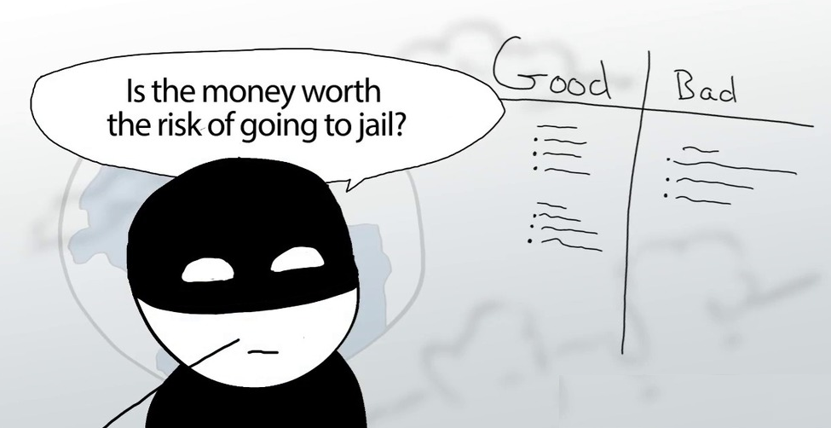
Rational Choice Theory
Notes:
Although RCT and UT can provide a theoretical framework which can be useful in some applications, in reality, the decision-making process of most individuals is very different from assumptions made by these frameworks. For example, people often make irrational decisions that are far from the core assumptions of the UT and RCT frameworks. In addition, in most cases, it is not easy to quantify the outcome of all actions or determine probabilities associated with different actions. Evidently, these considerations limit the practical applications of these theories.

Slide 7
Bounded Rationality
Acknowledges several limitations of UT and RCT as descriptive models of individual choice
People lack:
Perfect information of outcomes and probabilities
Consistent utility functions across domains
Time and cognitive capabilities to comprehensively enact the prescriptions of UT and RCT
Experts and everyday decision makers are error-prone
Notes:
Bounded Rationality framework was introduced to complement some of the shortcomings of the RCT and the UT by removing some of the strict assumptions from those theories.
For example, in the Bounded rationality theory, it is acknowledged that people may not have accurate estimates of probabilities associated to their action or to be able to establish a utility function that is consistent across different fields. For example, in judging the decision as to whether a student should skip a university class or not, the consequences are not of the same type. In this case, if the class is skipped the student may instead go to a party while attending the class gives him the opportunity to gain knowledge. It is challenging to have a utility function that can compare these two entirely different outcomes.
I general, although Bounded Rationality framework is more realistic, still it cannot capture the complex procedure involved in humans decision-making process in many cases. Moreover, it is known that humans make systematic errors that are repeated over the time and applies to many individuals. We refer to these systematic errors as cognitive biases and heuristics which are discussed next.

Slide 8
Cognitive Bias in Decision Making
Cognitive Biases are “Mental shortcut” used in judgment and decision making
Usually involves focusing on one aspect of a complex problem and ignoring others.
Essential for living in an uncertain world
But they can lead to faulty beliefs and suboptimal decisions
By looking at errors and biases, we can learn how people are reasoning under uncertainty
Notes:
let's see what it means by cognitive biases. Cognitive biases are mental shortcuts that are used when we make decisions. Of course, this results in humans to be able to make decisions faster which has been essential for mankind to be able to survive by quickly responding to the dangerous and life-threatening situations. However, since most cognitive biases force us to simplify the problem and to focus only on one particular aspect of a complex problem, the decisions are normally sub-optimal. The good news is that these cognitive biases have shown to be systematic which means that they have been reported to repeat over the time and apply to a large percentage of us. Therefore, by exploring these cognitive biases, we might be able to minimize their effect on your decision-making processes.

Slide 9
Few Well-known Cognitive Biases
The following cognitive biases are briefly examined in this presentation. Click here to see a more comprehensive list of cognitive biases
Availability Bias
Anchoring & Adjustment Bias
Representativeness Bias
Confirmation Bias
Notes:
The followings are some of the key cognitive biases that we will explore in this presentation.

Slide 10
Availability Bias
Causes us to base decisions on information that is more readily available in our memories, rather than the data we really need.
Consider these pairs of causes of death:
Lung Cancer vs Motor Vehicle Accidents
Emphysema vs Homicide
Tuberculosis vs Fire and Flames
From each pair, choose the one you think causes more deaths in the US each year.
Notes:
Let's starts with the availability bias. The availability bias forces us to base our decisions on information that is easily available in our memories rather than looking for and collecting information and data that is relevant to the problem. Let's describe this using an example. Consider these pairs of causes of death: Lung Cancer vs Motor Vehicle Accidents or Emphysema vs Homicide or TB vs Fire and Flames. Now take a piece of paper and write down the relative percentage of the people who you think have died in the US due to each of these causes when they are compared in pairs. For example, you may say the relative percentage of people died due to cancel compared to accidents is 40% to 60% etc. We will discuss the results shortly.

Slide 11
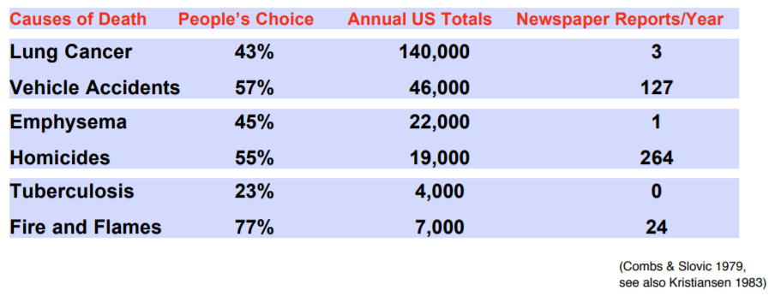
Availability Bias: Example
Notes:
Now let's compare the results with the facts. According to the Table, lung cancer kills 140,000 people per year in the US compared to only 46,000 people that die in car accidents. However, the average relative percentage of deaths due to accidents was indicated as 57% among survey participants.
So why this has happened? In other words, why people were under the impression that accidents cause more deaths compared to lung cancer where in reality the number of deaths caused due to lung cancer was almost three times?
Well, this is because accidents are much more frequently reported and therefore the information was fresh and easily available in the memory of the survey participants. For example, according to the table, there were only three newspaper reports of lung cancer cases compared to 127 cases of accidents in the year when the survey was conducted. Similar trends were observed when comparing Emphysema vs Homicide or TB vs Fire. These examples illustrate the effect of availability bias where we rely more on information that is fresh and easily available in our memories.

Slide 12
Availability Bias: Example
A doctor who has just diagnosed two cases of bacterial meningitis is likely to see it in the next patient, even though they only have the flu, which it resembles.
The same is true of shark attacks, which people think are relatively frequent because of media reports. In fact you’re more likely to be killed by a part that’s fallen off a plane, which in itself is unbelievably unlikely (Read, 1995).
Notes:
Here are two more examples: a doctor who has just diagnosed two patients with bacterial meningitis is likely to see it in the next patient, even though they only have the flu, which it resembles. The same is true of shark attacks, which people think are relatively frequent because of media reports while they are extremely unlikely in reality.

Slide 13
Anchoring & Adjustment Bias
People often estimate by adjusting an initial value until a final value is reached
Initial values might be due to the problem presentation or due to partial computations
Adjustments are typically insufficient and are biased towards initial values, the anchor
Notes:
Anchoring and adjustment is another type of cognitive bias. Anchoring and adjustment bias deals with how people estimate a quantity.
In most cases, people estimate various quantities using an initial starting point, and then they try to adjust that value. The initial starting point can be found based on how the problem is presented to them or by using some partial information about the problem. The problem is that the adjustments are in most cases insufficient and the final estimates are not far from the initial points. Therefore, it is said that people are anchored to the initial point, hence the name of the bias.

Slide 14
Anchoring & Adjustment Bias: Example
Two groups of individuals were asked to quickly guestimate the answer to the same arithmetic problem.
Group 1: 1×2×3×4×5×6×7×8=?
Mean Answer= 512
Group 2: 8×7×6×5×4×3×2×1=?
Mean Answer= 2250
Correct answer response : 40320
The above confirms the anchoring bias since the first group have been anchored to a lower value and then their adjustment was much smaller compared to the second group which started from a bigger number.
Notes:
Here is an example of the anchoring and adjustment bias in action. Two groups of people have been asked to estimate the value of 8! which is equal to one multiplied by two multiplied by three, all the way to eight. The problem, however, was presented to the two groups in different orders. The first group was asked to estimate the value of one multiplied by two multiplied by three, all the way to eight while the order was reversed for the second group. The average estimate for the first group was 512 while the average answer for the second group was 2250, significantly larger than the first group average. So why this has happened? Well, the first group started by multiplying small numbers: one multiplied by two is two, multiplied by three is six, multiplied by four is 24, and then they see few larger number at the end. The second group started with eight multiplied by seven which is 56 which was a much larger starting point, and therefore they come up with a much higher estimate.

Slide 15

Anchoring & Adjustment Bias: Example
Notes:
Anchoring and adjustment bias is widely practiced in marketing where marketers try to anchor customers by initially presenting them a high-price so that they would feel comfortable to pay the asking prices. How many times have you been tempted to buy an overpriced item just because the price is shown to be reduced from a much higher price?
https://flic.kr/p/cDqBb5

Slide 16
Representativeness Bias
A mental shortcut that helps us make a decision by comparing information to our mental prototypes.
Imagine a group of 70 lawyers and 30 engineers.
“Tom is a 30 year old man. He is married with no children. A man of high ability and high motivation, he promises to be quite successful in his field. He is well-liked by his colleagues.”
Participants judged Tom to be equally likely to be an engineer regardless of prior probability condition. Base probability was neglected!
Notes:
Let's move on to the representativeness bias now. This is the bias which pushes us to make decisions based on our mental prototypes and ignore other pieces of information that might be relevant. Consider the following example. Survey participants were told that there are 100 people in a group, 70 lawers, and 30 engineers. Tom is a member of this group and is described as a 30 years old man and no children. A person with high ability and high motivation who is well-liked by his colleagues. Participants were then asked if Tom was an engineer or a lawyer. Most people said that Tom is equally likely to be an engineer or a lawyer based on the given information. IIn other words, they only focused on matching Tom with their own mental picture of a lawyer or an engineer, and since the description did not reveal much information in that regards they said Tom was equally likely to be an engineer or a lawyer. They have completely forgotten that even if Tom was randomly selected from this group with no distinctive description, there was still a 70% chance that he was a lawyer considering the composition of the group. Instead, people were only focused on matching Tom to their mental prototypes of an engineer or a lawyer and ignored this information completely.

Slide 17
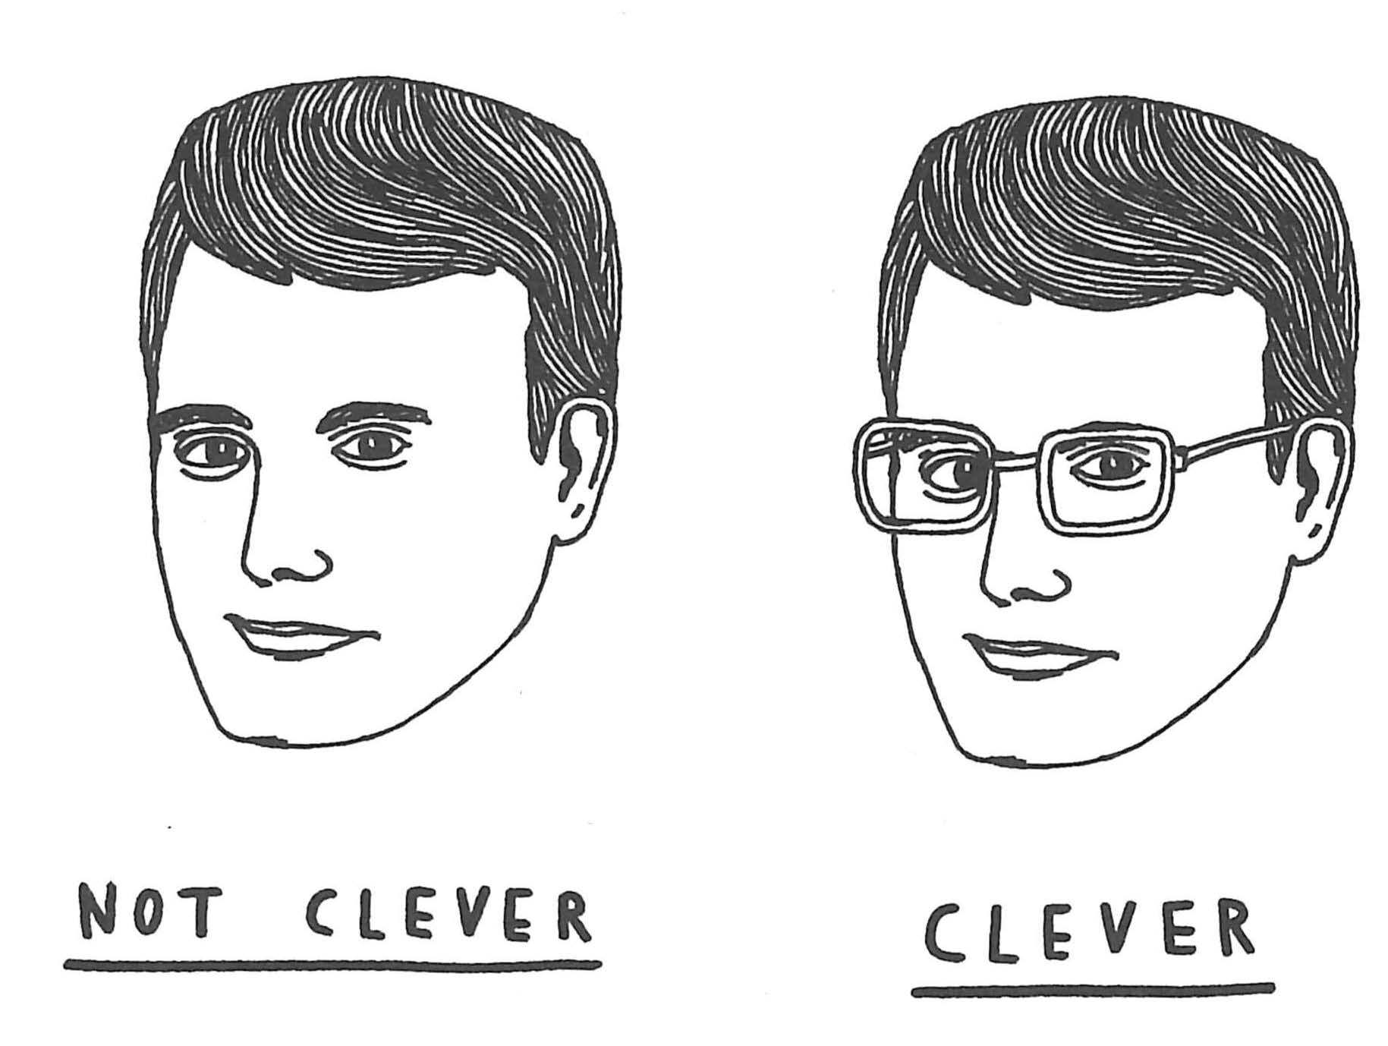
Representativeness Bias
Notes:
Pause for 10 seconds

Slide 18
Confirmation Bias
Confirmation bias inclines us to look for confirming evidence of an initial hypothesis, rather than falsifying evidence that would disprove it.
Confirmation bias occurs from the direct influence of desire on beliefs
Example: Investors may fall victim to the confirmation bias and make a serious blunder while making an investment. If an investor has a good opinion of a company, he might hold on to its stock, and ignore any bad reports about it.
Notes:
Next is the confirmation bias which inclines us to look for confirming evidence of an initial hypothesis, rather than falsifying evidence that would disprove it. An example of the confirmation bias is the decision-making process of an investor who is lean towards buying the stocks of a given company. In this case, he may only focus on positive points about the company which supports his intention for buying the stock and ignores warning signs.

Slide 19
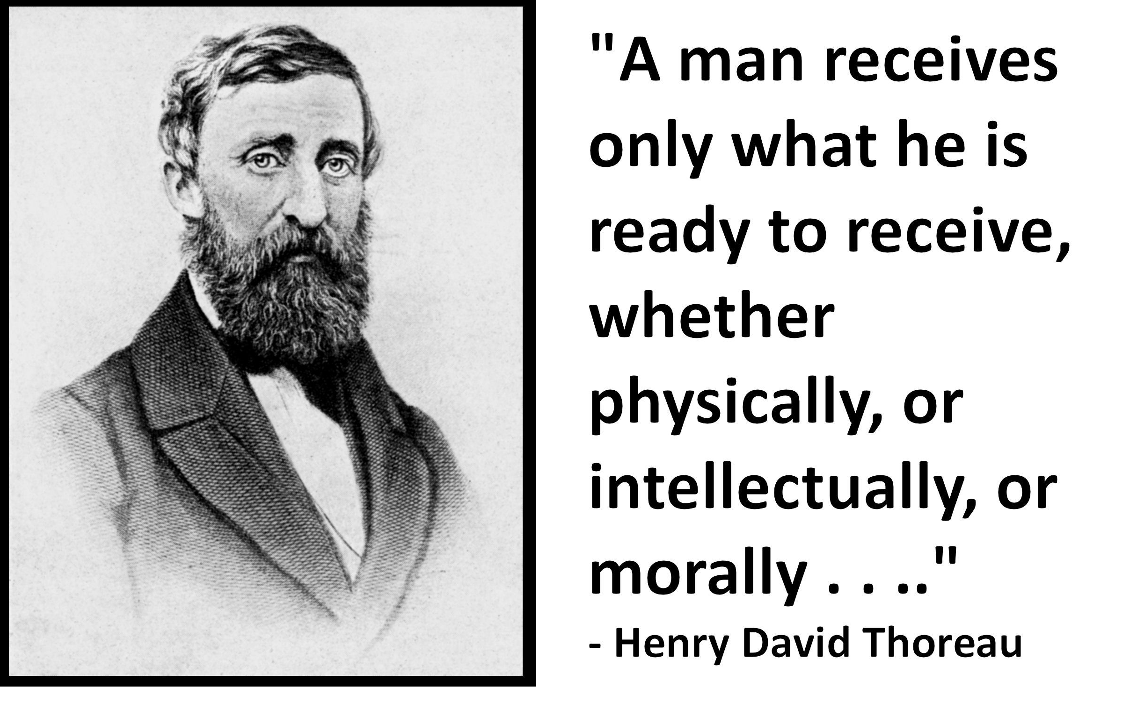
Confirmation Bias

Slide 20
“People put a lot less effort into picking apart evidence that confirms what they already believe.” Peter Watts, Echopraxia
In predictive analytics, various algorithms are deployed to mine data to find patterns with the goal making predictions.
Predictive analytics systems deploy more complex algorithms and are more computationally intensive
In Predictive Analytics systems the focus is in predicting the future as opposed to describing what has happened in the past which is the focous of BI systems.
Notes:
Pause for 12 seconds

Slide 21
Using Analytics to Avoid Cognitive Biases
Using data-driven approaches for making critical decisions is an effective way to minimize our vulnerabilities to cognitive biases
Making informed decisions based on facts rather than assumptions can lead to much more desirable outcomes
According to a study by Accenture Research, high performing firms found to be five times more likely to used analytics solutions for making strategic decisions.
Notes:
Earlier we saw that formal decision theories are insufficient to capture the complex decision-making process of human beings. Additionally, we saw that we are vulnerable to a number of systematic cognitive biases in our decision makings. Bear in mind that we only discussed a few examples of biases and the list is much more exhaustive. So what should we do t minimize the effects of these biases and vulnerabilities when making critical and strategic business decision where the consequences can be significant? Well, using data-driven methods can help us to focus on the facts instead of assumptions and provide us with a more holistic view of the problem. Numerous studies reported that the decision-making process would be significantly enhanced when relying on reliable data rather than assumptions. For example, according to Accenture Research, high performing firms were 5 times more likely to deploy data analytics solutions for their strategic decisions.

